Slide 1
Creating Similarity: Lateral Thinking for Vertical Similarity Judgments
Keyang
2014/4/23

Slide 2
Overview
Preliminary
  WordNet
  Google N-gram
Content of this Paper
  What Did They Do?
  How Did they Do It?
My Understanding and Opinions

Slide 3
Overview
Preliminary
  WordNet
  Google N-gram
Content of this Paper
  What Did They Do?
  How Did they Do It?
My Understanding and Opinions

Slide 4
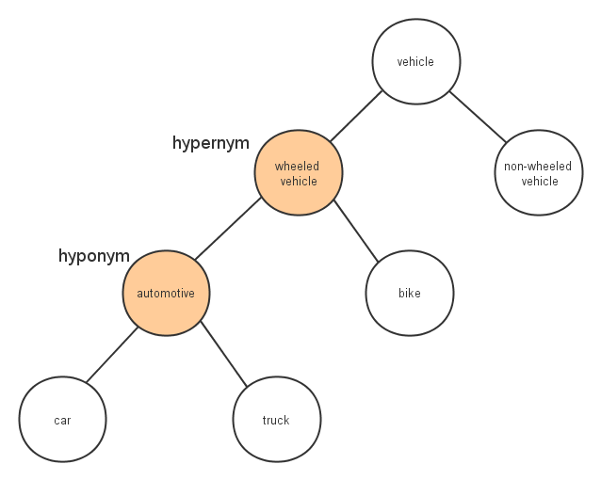
Is-a Relationship
X is a kind of Y
  Relation
    X is a Hyponymy of Y
    Y is a Hypernymy of X
  Property
    X is more specific than Y
    Y is more general than X
    X has all the properties that Y has, just as subclass/superclass in programming languages
Least Common Subsumer (LCS)

Slide 5
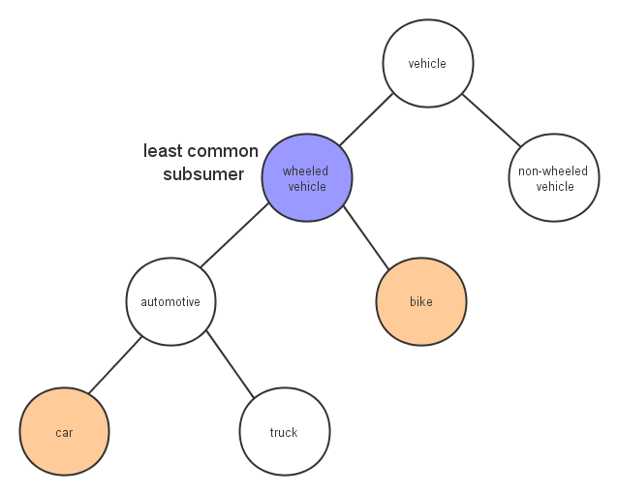
Is-a Relationship
X is a kind of Y
  Relation
    X is a Hyponymy of Y
    Y is a Hypernymy of X
  Property
    X is more specific than Y
    Y is more general than X
    X has all the properties that Y has, just as subclass/superclass in programming languages
Least Common Subsumer (LCS)

Slide 6
Overview
Preliminary
  WordNet
  Google N-gram
Content of this Paper
  What Did They Do?
  How Did they Do It?
My Understanding and Opinions

Slide 7
Google N-gram
Google Ngram Viewer
  Online phrase-usage graphing tool
  Count from books digitized by Google Inc
  Free download
  2010
Web Ngram
  Used in this paper
  Count from publicly accessible Web pages
  Paid for on LDC
  2006

Slide 8
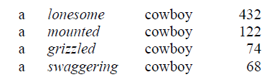
Google N-gram

Slide 9
Overview
Preliminary
  WordNet
  Google N-gram
Content of this Paper
  What Did They Do?
  How Did they Do It?
My Understanding and Opinions

Slide 10
What Did They Do?
Measuring Similarity (Conventional)
  Motivation
  Related Work and Ideas
Creating Similarity (Novel)
  Motivation
  Related Work and Ideas

Slide 11
What Did They Do?
Measuring Similarity (Conventional)
  Motivation
  Related Work and Ideas
Creating Similarity (Novel)
  Motivation
  Related Work and Ideas

Slide 12
Motivation of Measuring Similarity
Useful in many NLP applications
  QA system
  Information retrieval
Also useful in applications like recommendation system

Slide 13
What Did They Do?
Measuring Similarity (Conventional)
  Motivation
  Related Work and Ideas
Creating Similarity (Novel)
  Motivation
  Related Work and Ideas

Slide 14
Related Work of Measuring Similarity
Taxonomy-based
  Depth in the hierarchy
  Length of the shortest path
  Information content
  Using SVM to combine information from WordNet and from web.
Corpus-based
  Often Use cooccurence, LSA
  not our focus

Slide 15
What Did They Do?
Measuring Similarity (Conventional)
  Motivation
  Related Work and Ideas
Creating Similarity (Novel)
  Motivation
  Related Work and Ideas
Approaches
  First create, then measure!

Slide 16
Motivation of Creating
Similarity
“Metaphors shape the way we perceive the world by re-shaping the way we make similarity judgments. So if we want to imbue computers with the ability to make and to understand creative metaphors, we must first give them the ability to look beyond the narrow viewpoints of conventional resources.”
e.g. “cigarettes are time bombs”

Slide 17
What Did They Do?
Measuring Similarity (Conventional)
  Motivation
  Related Work and Ideas
Creating Similarity (Novel)
  Motivation
  Related Work and Ideas

Slide 18
Related Work of Creating Similarity
Some justifications
  Vertical thinking vs. Lateral thinking
  There is experimental evidence for the claim that “metaphors do not use preexisting associations to achieve their effects. People use metaphors to create new relations between concepts.”

Slide 19
Overview
Preliminary
  WordNet
  Google N-gram
Content of this Paper
  What Did They Do?
  How Did they Do It?
My Understanding and Opinions

Slide 20
How Did They Do It?
Approaches
  First create, then measure
  Creating Similarity
  Measuring Similarity
Evaluation
  Dataset and results

Slide 21
How Did They Do It?
Approaches
  First create, then measure
  Creating Similarity
  Measuring Similarity
Evaluation
  Dataset and results

Slide 22
First Create, then Measure
Create
  Build hundreds of fine-grained categories, which are candidates of the next step
  Generative and divergent
Measure
  Find the qualified candidates to construct feature vectors
  Selective and convergent

Slide 23
How Did They Do It?
Approaches
  First create, then measure
  Creating Similarity
  Measuring Similarity
Evaluation
  Dataset and results

Slide 24
Basic Properties
Extract properties for each concept from the Google Web n-grams

Slide 25
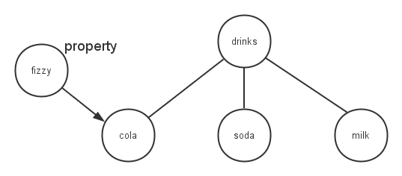
Bootstrap
Notation
  P --> property
  C --> concept
  S --> subsumer
Query
  P * such as C (using * to match S)
    A valid P-S will be a fine-grained category
    e.g. "fizzy * such as cola" * can match drinks
  P S such as * and C
    Those matched by * are new C in P-S
    e.g. "fizzy drinks such as * and cola" * can match soda
    Continue to query "fizzy drinks such as * and soda"

Slide 26
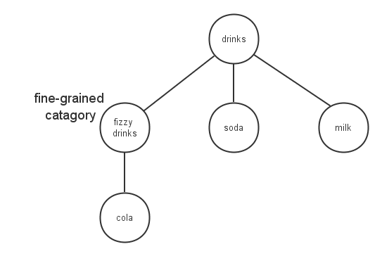
Bootstrap
Notation
  P --> property
  C --> concept
  S --> subsumer
Query
  P * such as C (using * to match S)
    A valid P-S will be a fine-grained category
    e.g. "fizzy * such as cola" * can match drinks
  P S such as * and C
    Those matched by * are new C in P-S
    e.g. "fizzy drinks such as * and cola" * can match soda
    Continue to query "fizzy drinks such as * and soda"

Slide 27
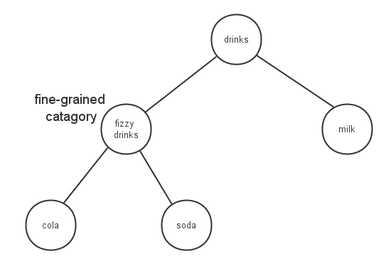
Bootstrap
Notation
  P --> property
  C --> concept
  S --> subsumer
Query
  P * such as C (using * to match S)
    A valid P-S will be a fine-grained category
    e.g. "fizzy * such as cola" * can match drinks
  P S such as * and C
    Those matched by * are new C in P-S
    e.g. "fizzy drinks such as * and cola" * can match soda
    Continue to query "fizzy drinks such as * and soda"

Slide 28
How Did They Do It?
Approaches
  First create, then measure
  Creating Similarity
  Measuring Similarity
Evaluation
  Dataset and results

Slide 29
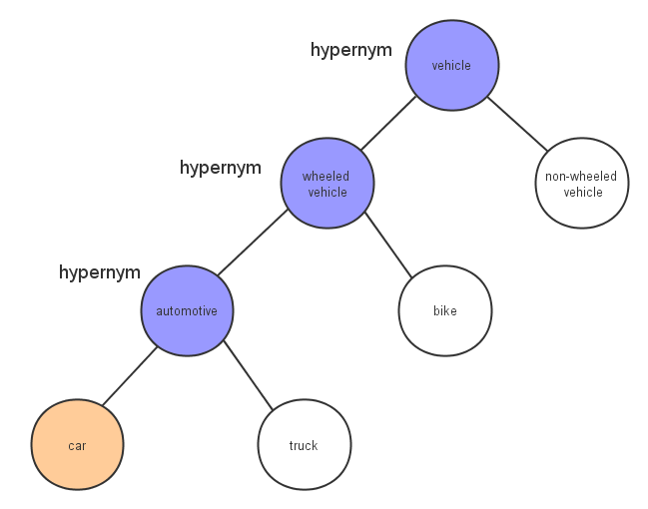
Construct Feature Vector
Dimensions are hypernyms
  Direct and indirect
Weights in these dimensions are determined by information content

Slide 30
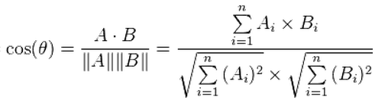
Calculate Cosine-distance
Standard approach to calculating the distance between two vectors

Slide 31
How Did They Do It?
Approaches
  First create, then measure
  Creating Similarity
  Measuring Similarity
Evaluation
  Dataset and results

Slide 32
Evaluation
Dataset
  human judges on the 30-pair word set of Miller & Charles
Three versions
  Rex-wn --> With no found categories added
  Rex-lat --> With all found categories added
  Rex-pop --> With only the popular categories added
    What is popular? ">=5 times"

Slide 33
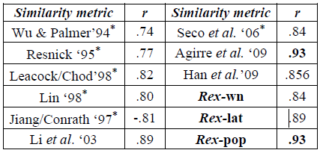
Evaluation

Slide 34
Overview
Preliminary
  WordNet
  Google N-gram
Content of this Paper
  What Did They Do?
  How Did they Do It?
My Understanding and Opinions

Slide 35
My Understanding and Opinions
Good structure
  First create(lateral thinking), then measure(vertical thinking)
Could the lateral part be used somewhere else?
  Now there is only a online demo
  Understand and create metaphors?
  Using context?
The "5" in Rex-pop is suspicious

Slide 36
My Understanding and Opinions
Good structure
  First create(lateral thinking), then measure(vertical thinking)
Could the lateral part be used somewhere else?
  Now there is only a online demo
  Understand and create metaphors?
  Using context?
The "5" in Rex-pop is suspicious

Slide 37
My Understanding and Opinions
Good structure
  First create(lateral thinking), then measure(vertical thinking)
Could the lateral part be used somewhere else?
  Now there is only a online demo
  Understand and create metaphors?
  Using context?
The "5" in Rex-pop is suspicious

Slide 38
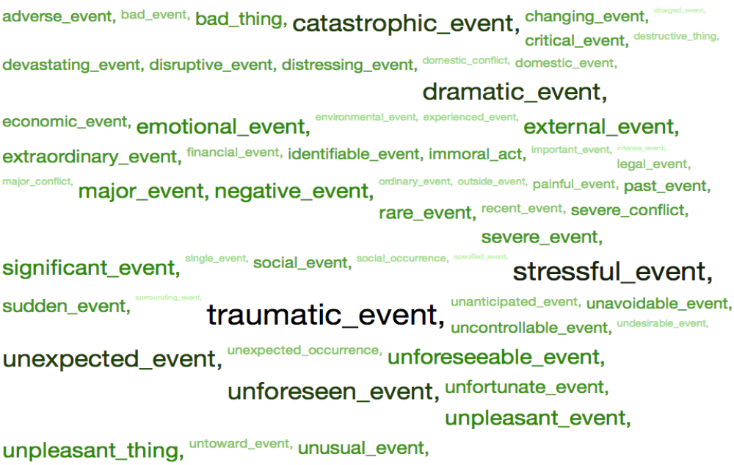
Online Demo
Divorce and War

Slide 39
My Understanding and Opinions
Good structure
  First create(lateral thinking), then measure(vertical thinking)
Could the lateral part be used somewhere else?
  Now there is only a online demo
  Understand and create metaphors?
  Using context?
The "5" in Rex-pop is suspicious

Slide 40
Understand and create metaphors?
“Metaphors shape the way we perceive the world by re-shaping the way we make similarity judgments. So if we want to imbue computers with the ability to make and to understand creative metaphors, we must first give them the ability to look beyond the narrow viewpoints of conventional resources.”

Slide 41
My Understanding and Opinions
Good structure
  First create(lateral thinking), then measure(vertical thinking)
Could the lateral part be used somewhere else?
  Now there is only a online demo
  Understand and create metaphors?
  Using context?
The "5" in Rex-pop is suspicious

Slide 42
My Understanding and Opinions
Good structure
  First create(lateral thinking), then measure(vertical thinking)
Could the lateral part be used somewhere else?
  Now there is only a online demo
  Understand and create metaphors?
  Using context?
The "5" in Rex-pop is suspicious

Slide 43
Thanks!
Keyang
2014/4/23

